Slide 1

Estimation Part III:
Hierarchical Bayesian Modeling and Bayesian Model Averaging
Module 7 Live Session (7/06/2021)
DS6040 Summer 2021
Teague R. Henry

Slide 2

Course Updates
Resubmission HW1 deadline 7/9
HW3 Due 7/16

Slide 3
Outline
Nested Data - What is it, and why does it matter?
Hierarchical Bayesian Models in PyMC3
Ensemble Methods in Machine Learning
Bayesian Model Averaging - GLMs

Slide 4
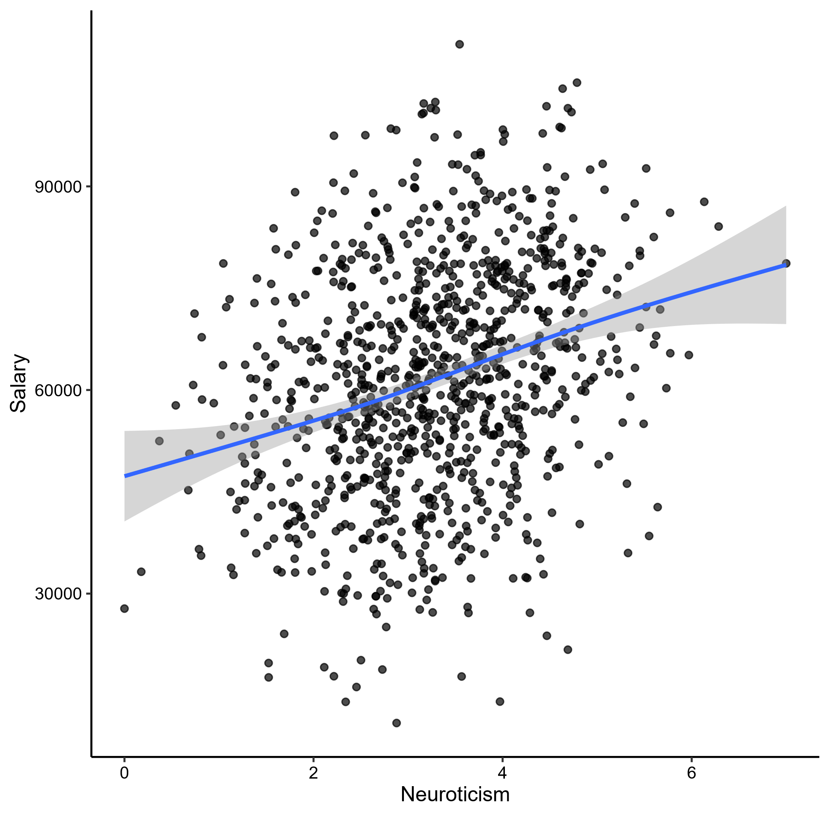
Nested Data
The most used models, Bayesian or Frequentist, assume conditional IID
Conditional on the model and data, all observations are identically and independently distributed.
It is rare that any interesting data is conditionally IID.
Sales of big box stores
Students within classrooms
Medical history of family members
Violations of conditional IID are Bad.

Slide 5
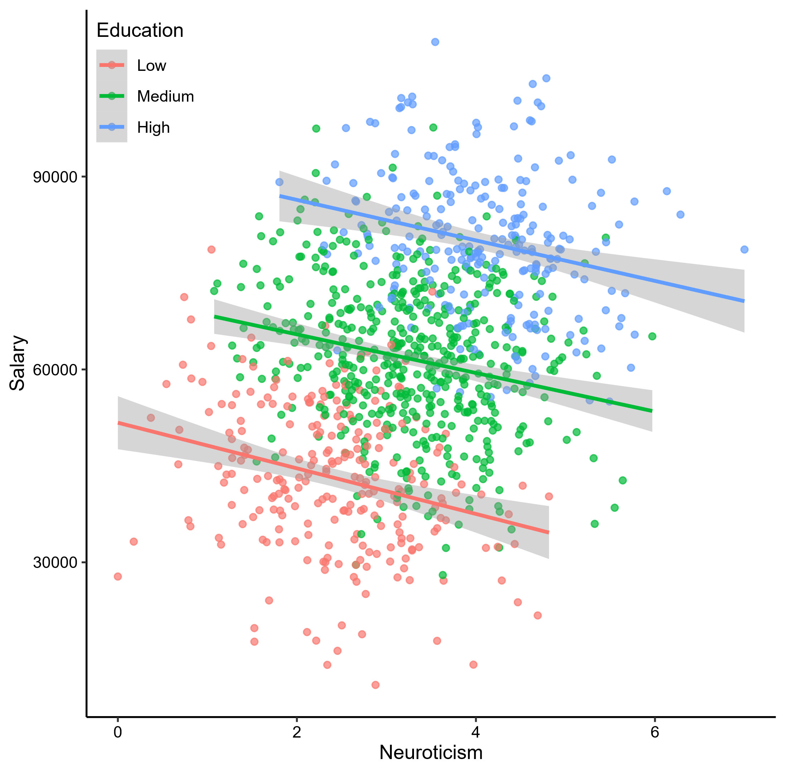
Nested Data
From https://paulvanderlaken.com/2017/09/27/simpsons-paradox-two-hr-examples-with-r-code/

Slide 6
Simpson’s Paradox
Also known as the aggregation paradox.
When the overall trend looks nothing like the actual within group trends.
Can lead to completely incorrect conclusions.
Other consequences –
Inflated standard errors
Reduction in power
Very very poor generalizability

Slide 7
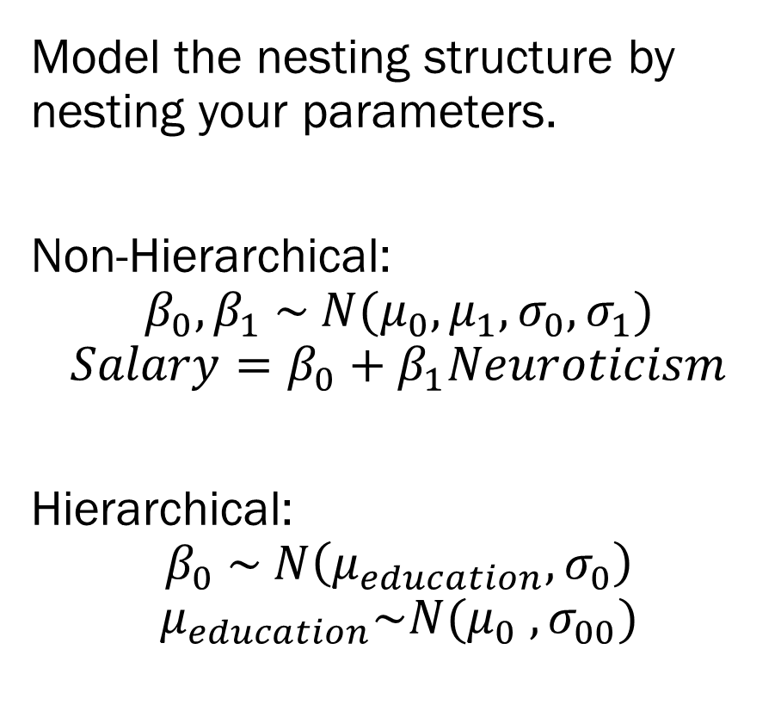
Hierarchical Bayes
Model the nesting structure by nesting your parameters.
Non-Hierarchical:
$$β_{0},β_{1} \sim N(μ_{0},μ_{1}, σ_{0}, σ_{1})$$
$$Salary=β_{0}+β_{1}Neuroticism$$
Hierarchical:
$$β_{0} \sim N\left(μ_{education}, σ_{0}\right)$$
$$μ_{education}\sim N(μ_{0} , σ_{00})$$

Slide 8
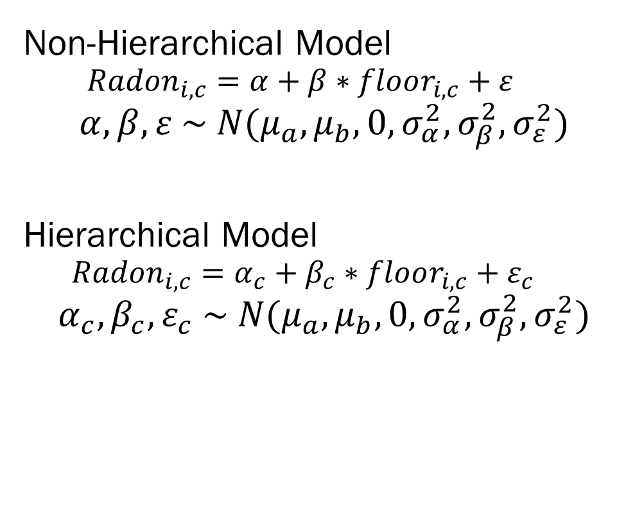
Hierarchical Bayes – Radon Example
Radon data set (Gelman et al., 2007)
Radioactive gas that can seep into houses
Data from 85 Minnesota counties
Basements/soil types impact radon
Great dataset for demonstrating hierarchical Bayes!
Non-Hierarchical Model
$$Radon_{i,c}=α+β∗floor_{i,c}+ε$$
$$α,β,ε \sim N(μ_{a}, μ_{b},0, σ_{α}^{2},σ_{β}^{2},σ_{ε}^{2})$$
Hierarchical Model
$$Radon_{i,c}=α_{c}+β_{c}∗floor_{i,c}+ε_{c}$$
$$α_{c},β_{c},ε_{c} \sim N(μ_{a}, μ_{b},0, σ_{α}^{2},σ_{β}^{2},σ_{ε}^{2})$$
This example is a combination of Danne Elbers & Thomas Wiecki’s
https://docs.pymc.io/notebooks/GLM-hierarchical.html
And Thomas Wiecki’s
https://twiecki.io/blog/2017/02/08/bayesian-hierchical-non-centered/

Slide 9
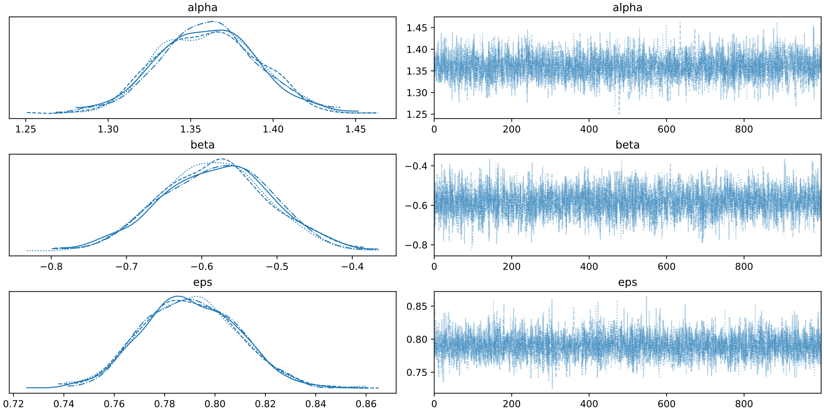
Hierarchical Bayes – Non-Hierarchical
Non-Hierarchical Model
Note that it converges, it looks fine.
Nested data doesn’t cause convergence issues
Nested data is a model misspecification issue…
This example is a combination of Danne Elbers & Thomas Wiecki’s
https://docs.pymc.io/notebooks/GLM-hierarchical.html
And Thomas Wiecki’s
https://twiecki.io/blog/2017/02/08/bayesian-hierchical-non-centered/

Slide 10
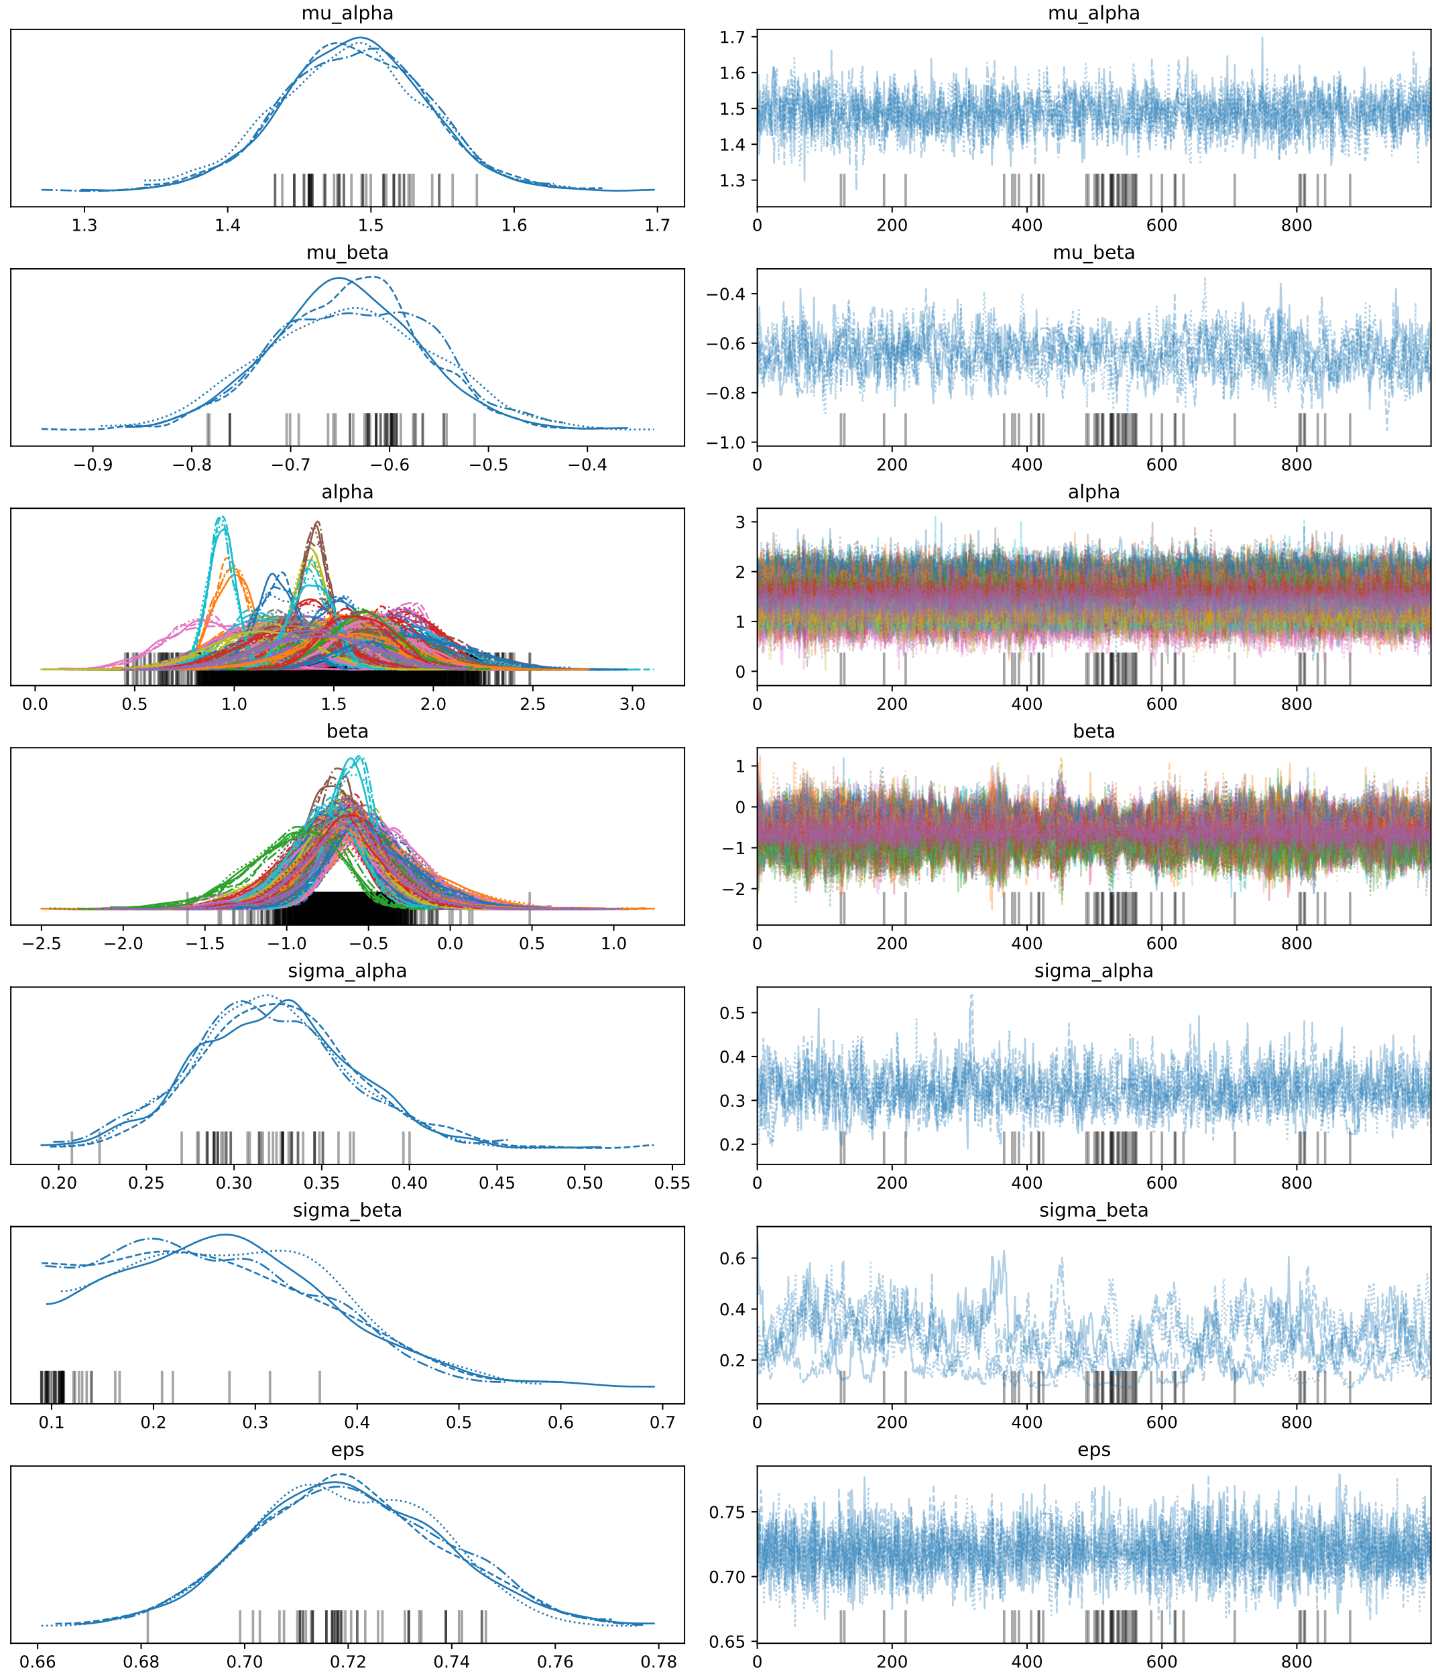
Hierarchical Bayes
Hierarchical Model
54 divergences, ESS < 200 for some parameters.
Substantial variability in the county level intercept, with less in the county level effect of basement.
Overall, this might seem like it looks good to report…
The black bars denote divergence events.
This example is a combination of Danne Elbers & Thomas Wiecki’s
https://docs.pymc.io/notebooks/GLM-hierarchical.html
And Thomas Wiecki’s
https://twiecki.io/blog/2017/02/08/bayesian-hierchical-non-centered/

Slide 11
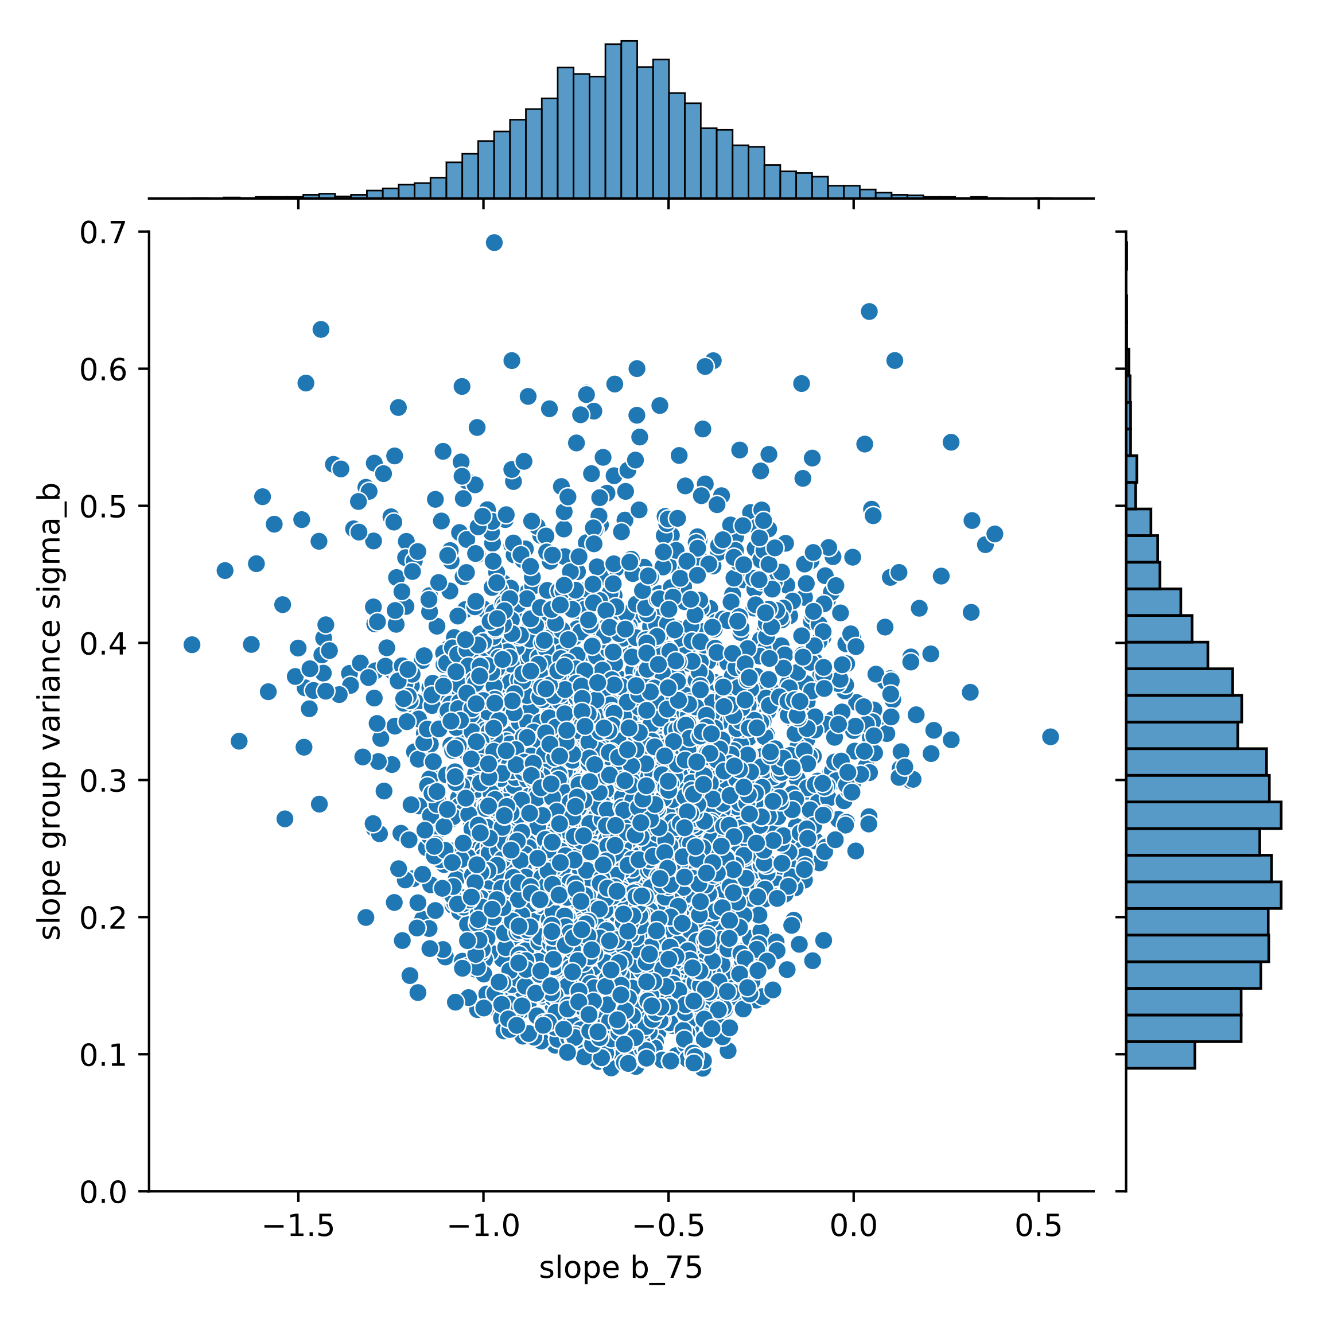
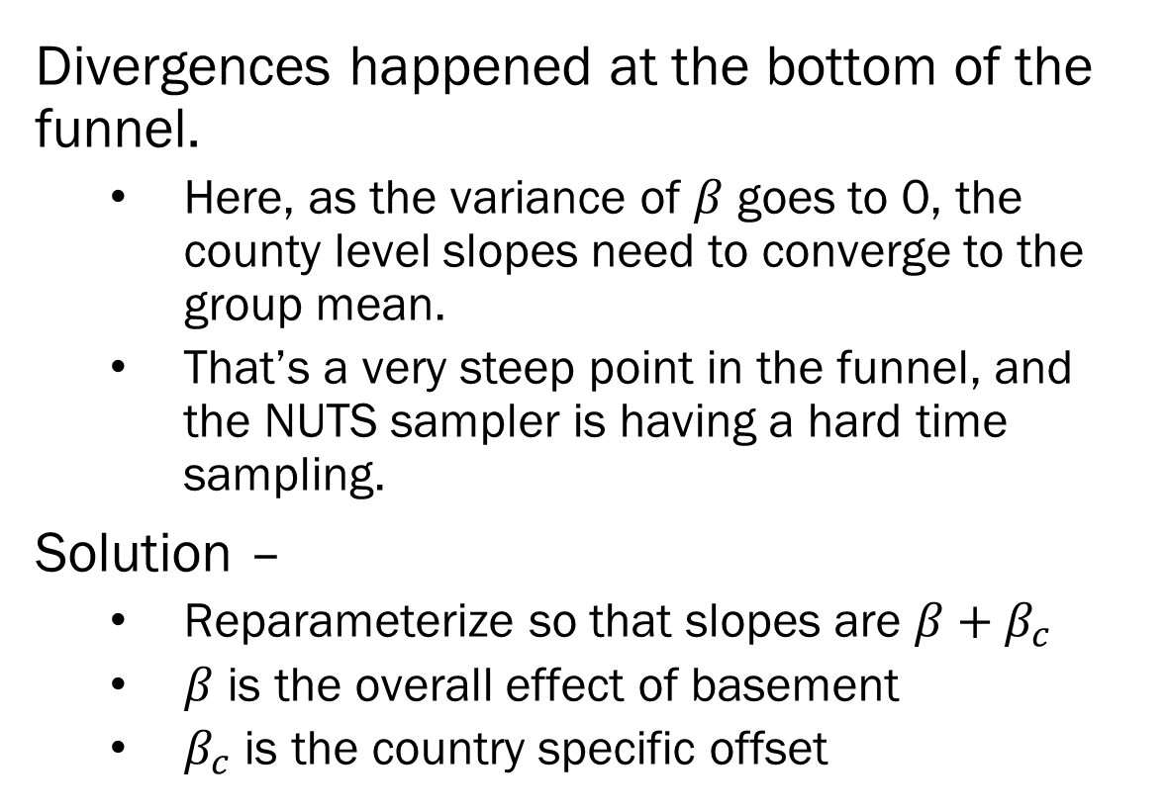
Hierarchical Bayes
Divergences happened at the bottom of the funnel.
Here, as the variance of $β$ goes to 0, the county level slopes need to converge to the group mean.
That’s a very steep point in the funnel, and the NUTS sampler is having a hard time sampling.
Solution –
Reparameterize so that slopes are $β+β_{c}$
$β$ is the overall effect of basement
$β_{c}$ is the country specific offset
This example is a combination of Danne Elbers & Thomas Wiecki’s
https://docs.pymc.io/notebooks/GLM-hierarchical.html
And Thomas Wiecki’s
https://twiecki.io/blog/2017/02/08/bayesian-hierchical-non-centered/

Slide 12
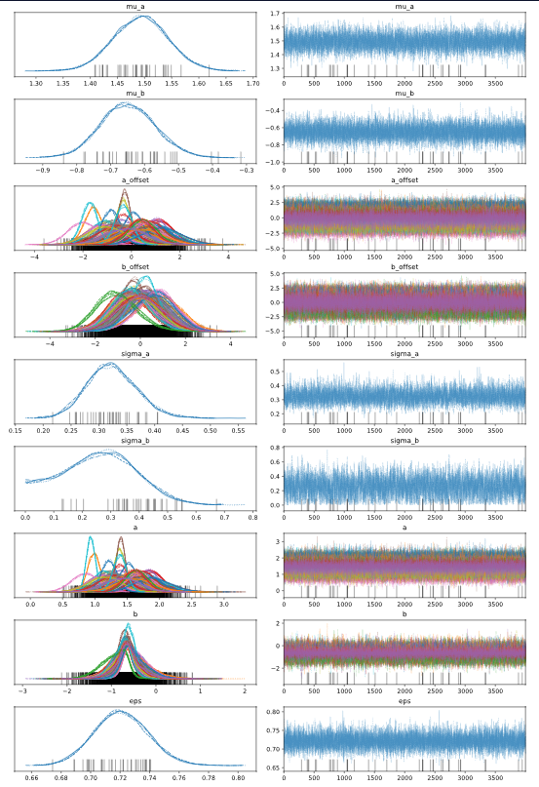
Hierarchical Bayes- Non-Centered
Fewer divergences, and more uniformly distributed.
The centered vs non-centered models are statistically equivalent
Hierarchical model let county differences in average radon come through.
This radically improves our predictive power.
Reparameterization fixed issues with slope estimation
Usually easier to sample from things with known means. That trick worked here.
This example is a combination of Danne Elbers & Thomas Wiecki’s
https://docs.pymc.io/notebooks/GLM-hierarchical.html
And Thomas Wiecki’s
https://twiecki.io/blog/2017/02/08/bayesian-hierchical-non-centered/

Slide 13
Ensemble Methods in Machine Learning
Individual models are prone to issues
Did you choose the right model specification?
Is the sample truly representative?
Is the model overfit?
One solution is to combine multiple models into an ensemble
Bagging, Boosting, Random Forests are all ensemble methods
Bayesian Model Averaging was the first ensemble method!

Slide 14
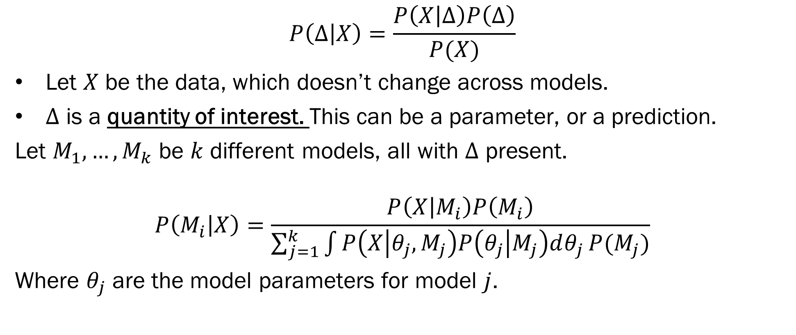
Bayesian Model Averaging
$$P\left(Δ | X\right)=\frac{P\left(X | Δ\right)P\left(Δ\right)}{P(X)}$$
Let $X$ be the data, which doesn’t change across models.
$Δ$ is a quantity of interest. This can be a parameter, or a prediction.
Let $M_{1}, …, M_{k}$ be $k$ different models, all with $Δ$ present.
$$P\left(M_{i} | X\right)=\frac{P\left(X | M_{i}\right)P\left(M_{i}\right)}{\sum_{j=1}^{k}{\int{P\left(X | θ_{j}, M_{j}\right)P\left(θ_{j} | M_{j}\right)dθ_{j}}P(M_{j})}}$$
Where $θ_{j}$ are the model parameters for model $j$.

Slide 15
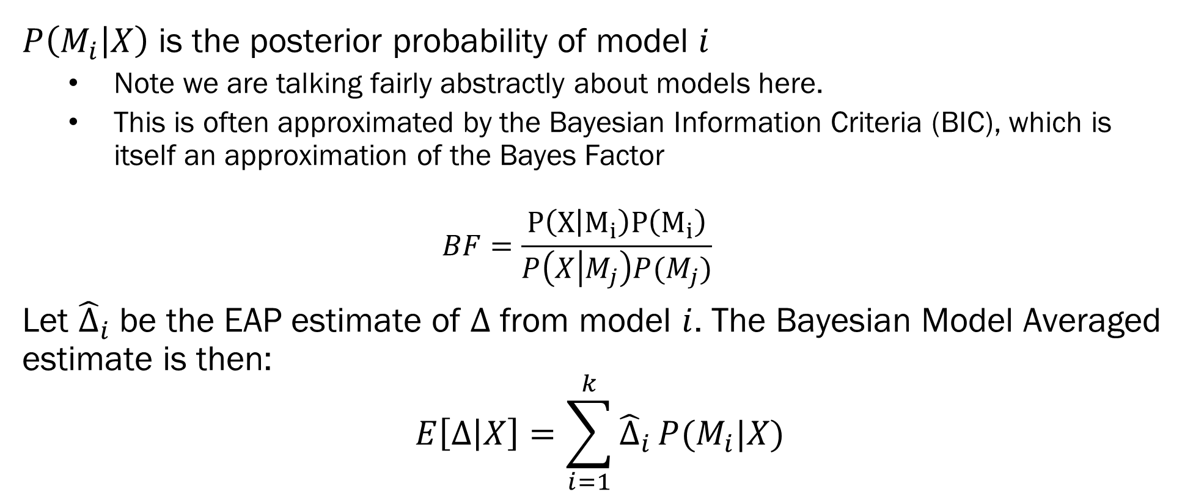
Bayesian Model Averaging
$P\left(M_{i} | X\right)$ is the posterior probability of model $i$
Note we are talking fairly abstractly about models here.
This is often approximated by the Bayesian Information Criteria (BIC), which is itself an approximation of the Bayes Factor
$$BF=\frac{P\left(X | M_{i}\right)P\left(M_{i}\right)}{P\left(X | M_{j}\right)P(M_{j})}$$
Let ${\hat{Δ}}_{i}$ be the EAP estimate of $Δ$ from model $i$. The Bayesian Model Averaged estimate is then:
$$E\left[Δ | X\right]=\sum_{i=1}^{k}{{\hat{Δ}}_{i}}P(M_{i}|X)$$

Slide 16
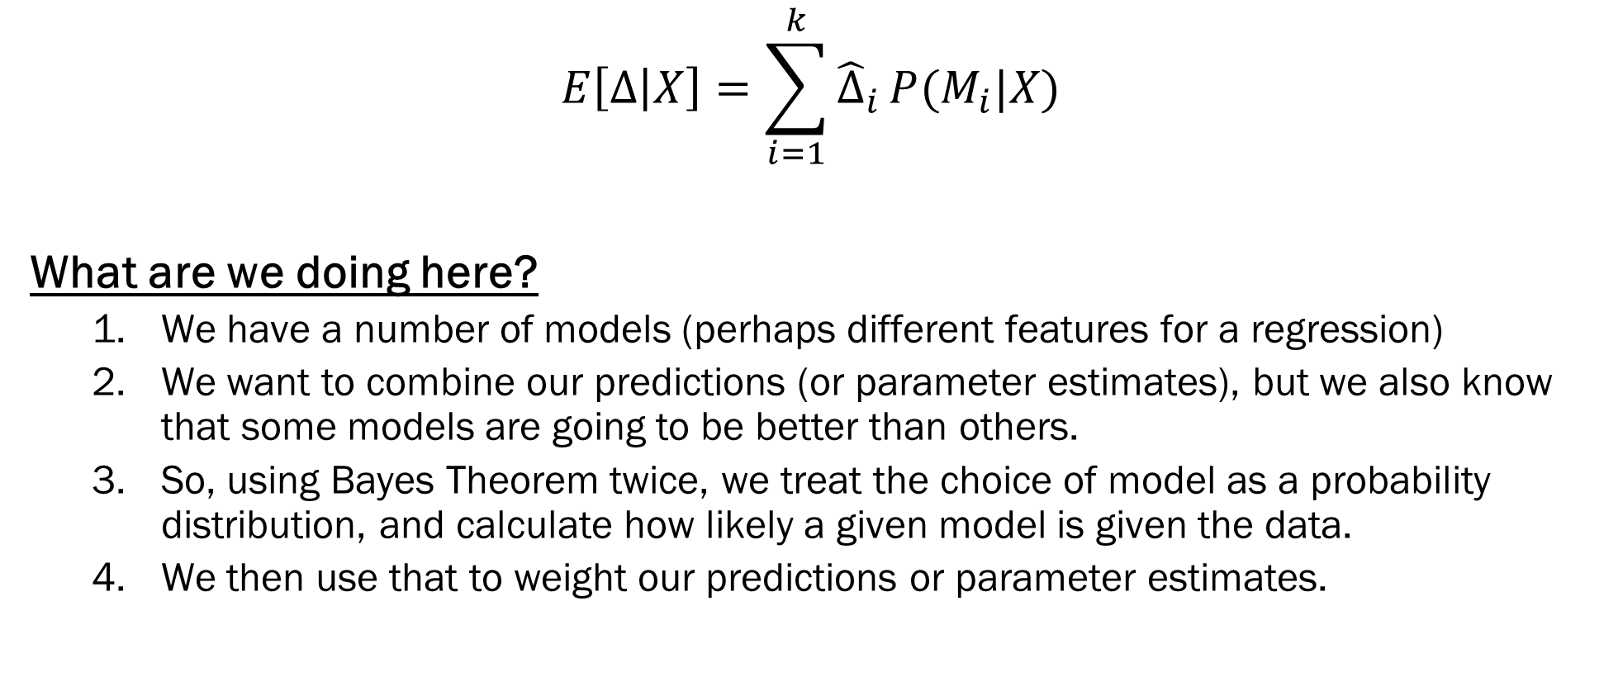
Bayesian Model Averaging
$$E\left[Δ | X\right]=\sum_{i=1}^{k}{{\hat{Δ}}_{i}}P(M_{i}|X)$$
What are we doing here?
We have a number of models (perhaps different features for a regression)
We want to combine our predictions (or parameter estimates), but we also know that some models are going to be better than others.
So, using Bayes Theorem twice, we treat the choice of model as a probability distribution, and calculate how likely a given model is given the data.
We then use that to weight our predictions or parameter estimates.

Slide 17
Bayesian Model Averaging - Issues
BMA seems simple, but is not that straightforward
What space of models are you looking over?
All posterior probabilities for models are relative to the set of models you are examining.
You’ll need to fit each model individually, are they easy to estimate?
You might have 1000s of models to estimate.
Most applications of BMA rely on properties of the general linear model
i.e. linear, logistic regression
Taking advantage of conjugate prior distributions.
Word of Warning: BMA is a very complex field, with many super advanced methods that solve important issues (e.g. mixtures of hyper g-priors). Think carefully when applying BMA.

Slide 18
Bayesian Model Averaging- Wine Alcohol
Recall that we used Bayesian Regression to predict red wine alcohol content from just 2 other predictors.
Question: What are the best predictors of alcohol content?
Answer: Use BMA to compute variable inclusion probabilities!
Variable Inclusion Probabilities –
Represents how “often” a variable is in a good model
Variable | Probability of Variable Inclusion
Fixed Acidity | .998
Volatile Acidity | .053
Citric Acid | 1
Residual Sugar | .992
Chlorides | 1
Free Sulfur Dioxide | .348
Total Sulfur Dioxide | 1
Density | .999
pH | 1
Sulphates | 1

Slide 19
Summary
Hierarchical Models –
Allow parameters to be random variables with respect to clustering
Useful for modeling nested data
Not modeling nested data is problematic
Bayesian Model Averaging –
Theoretically, any set of models can be averaged together
Practically, you should really only be averaging regression-type models
If you’d like to use advanced BMA methods, just be very cautious, there are a number of paradoxes that can occur with BMA…
For example – with huge amounts of data, standard BMA selects 1 model and ignores the rest.

Slide 20
Homework 4
Homework 4 will involve fitting Bayesian hierarchical models to data.
You will fit GLMs using PyMC3s GLM interface rather than building each piece
I’ll provide a notebook walking you through an example that will build up to the HW problem
Implementation should be simple/straight forward. Focus on interpretation…
You will also use BMA to further explore the white wine dataset!
Using Bill Basener’s implementation of logistic regression BMA
Code will be provided!
Use BMA to both refine our predictions and to explore what are the best predictors of wine quality.

